Slide 1
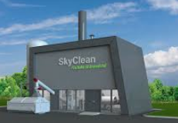
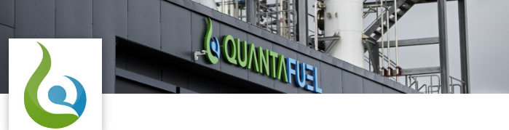

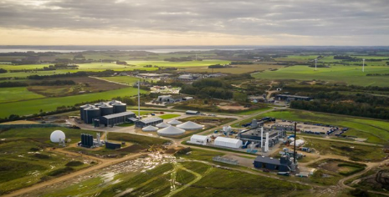

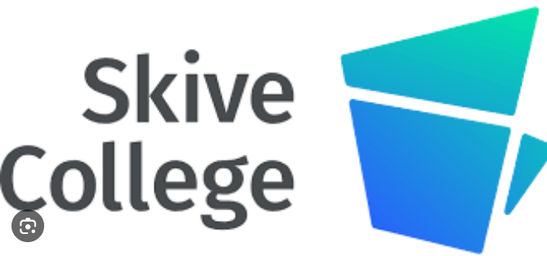
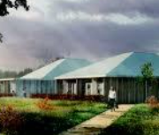
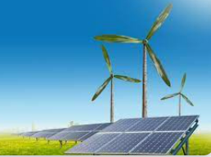


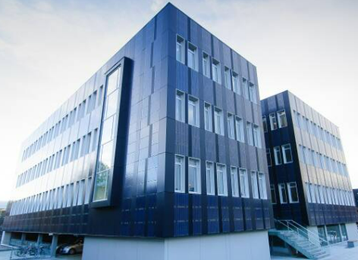


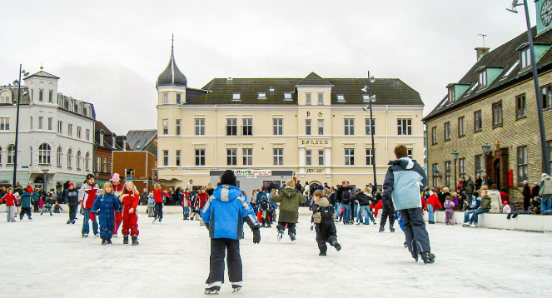



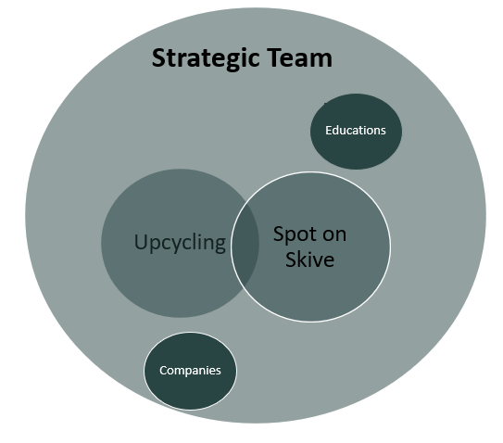
Skive is Denmarks ”go to place”
For four decades, Skive has been a market leader in the development of sustainable energy – today, this creates growth and development through green initiatives.
The driving force is proximity, community, and the unique entrepreneurial spirit that characterizes our region. Ideas become actions – this is how we create the future.
For example, Greenlab is a testament to our ability to establish clusters through collaboration, innovation, and development. This is the foundation for further development of what we have created over the past 10 years of cross-regional collaboration.

Slide 2
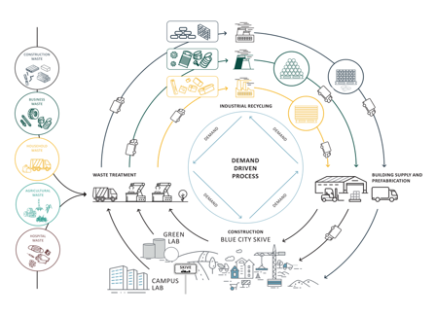
Regional and business development = Hub and clusters.
The Growth Team has been working together with the Energy City for the last 1.5 years on a national project called CEBW – Circular Economy Beyond Waste.
The main goal of the project is to establish companies in Denmark that, on a full scale, produce new raw materials from residual materials from construction and other industries – Industrial Recycling for Construction (IRC).

Slide 3
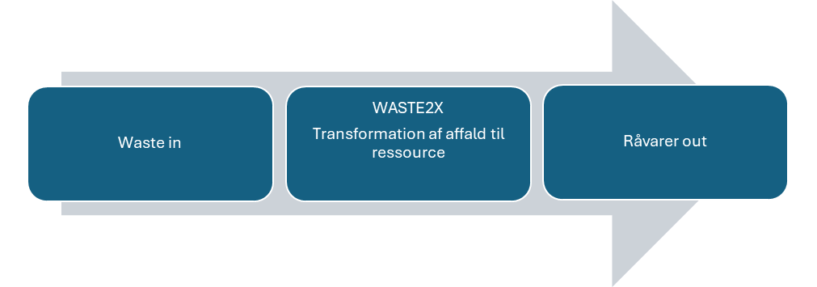
A green industriel hub in the Skive region
X2X
Establishing an industrial hub focuses on cost savings and resource optimization through collaboration, thereby maximizing the output that can be generated from these resources. It offers both economic and environmental benefits. Firstly, it enables existing businesses—both private and public—to enhance their profitability and competitiveness by reducing resource-related costs. Secondly, it significantly benefits the environment by lowering the demand for both raw materials and waste, which in turn results in a substantial reduction in CO2 emissions from the raw materials and products produced at the hub..
Waste2X
Bio2X
Power2X
Waste2
byg
Bio2
byg

Slide 4
Waste2X - a hub of new industrial companies.
X2X
Waste2X is one of the 9 prioritized projects in the growth strategy developed by Skive municipality, the companies and the educational institutions and anchored in this triple helix.
Waste2X
Waste2
byg

Slide 5
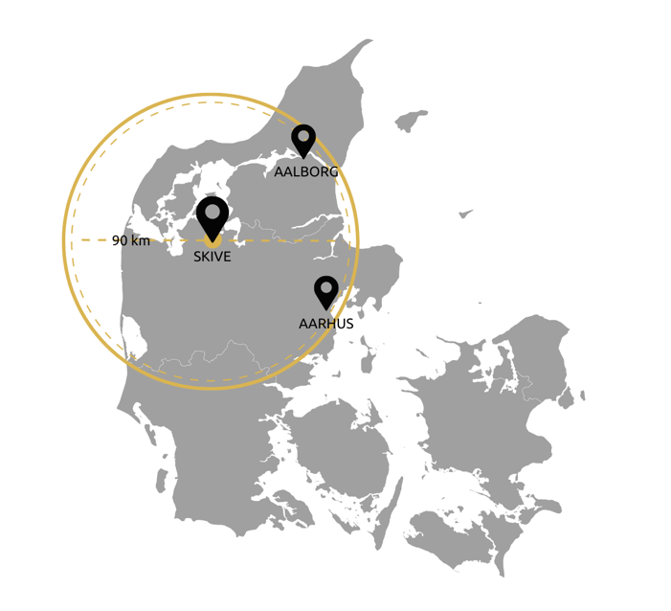
Skive as a center for waste2X

Slide 6
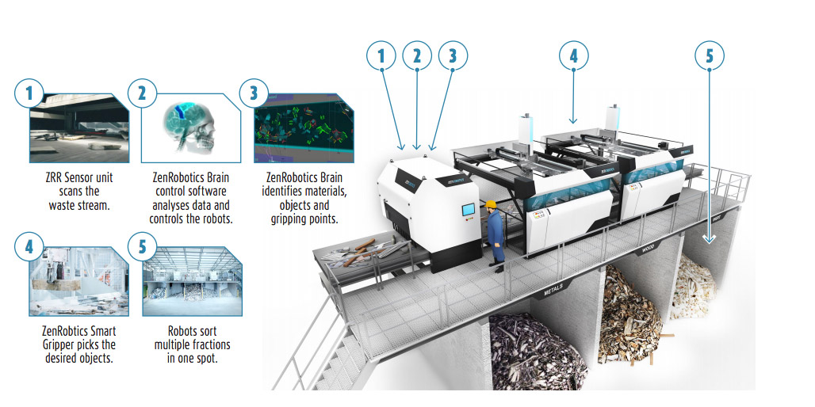

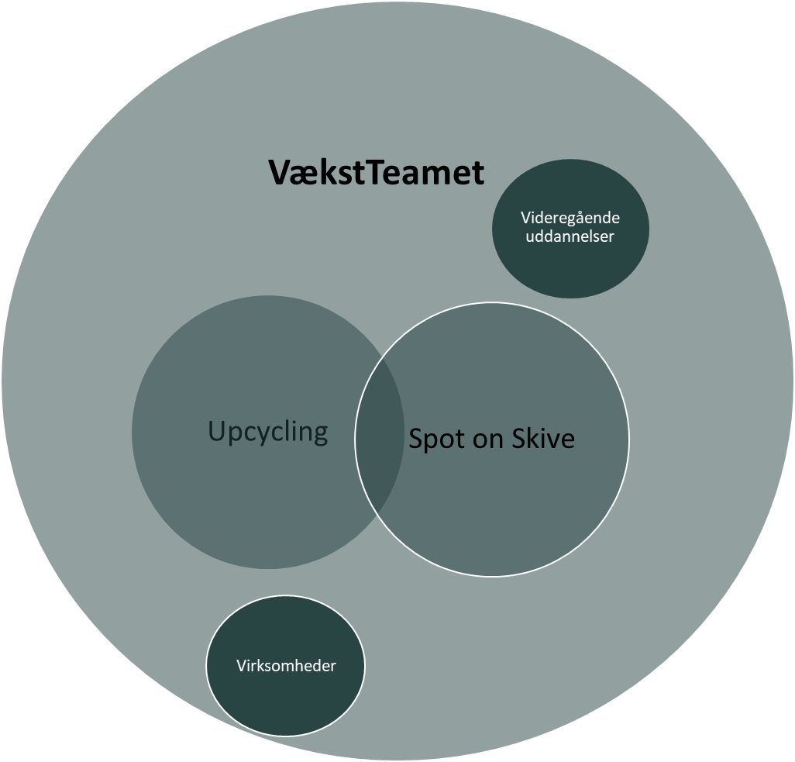
Facts about automated industrial sorting of waste
Two robotic arms can handle up to 4,000 picks per hour. In comparison, a human typically handles 700 picks per hour.
The system sorts different types of materials as well as different objects simultaneously. This reduces the need for complex pre-treatment of waste.
A single robotic arm can sort up to 4 different fractions – with high precision and up to 98% purity.
It sorts items weighing up to 20 kg. The robotic arm can open from 50 to 500 mm. Each robotic arm operates within a 2 x 2 meter area, enabling a high level of sorting efficiency.
Video: BBC News - Click, Sustainable Buildings, Rubbish sifting robots recycle demolition waste

Slide 7
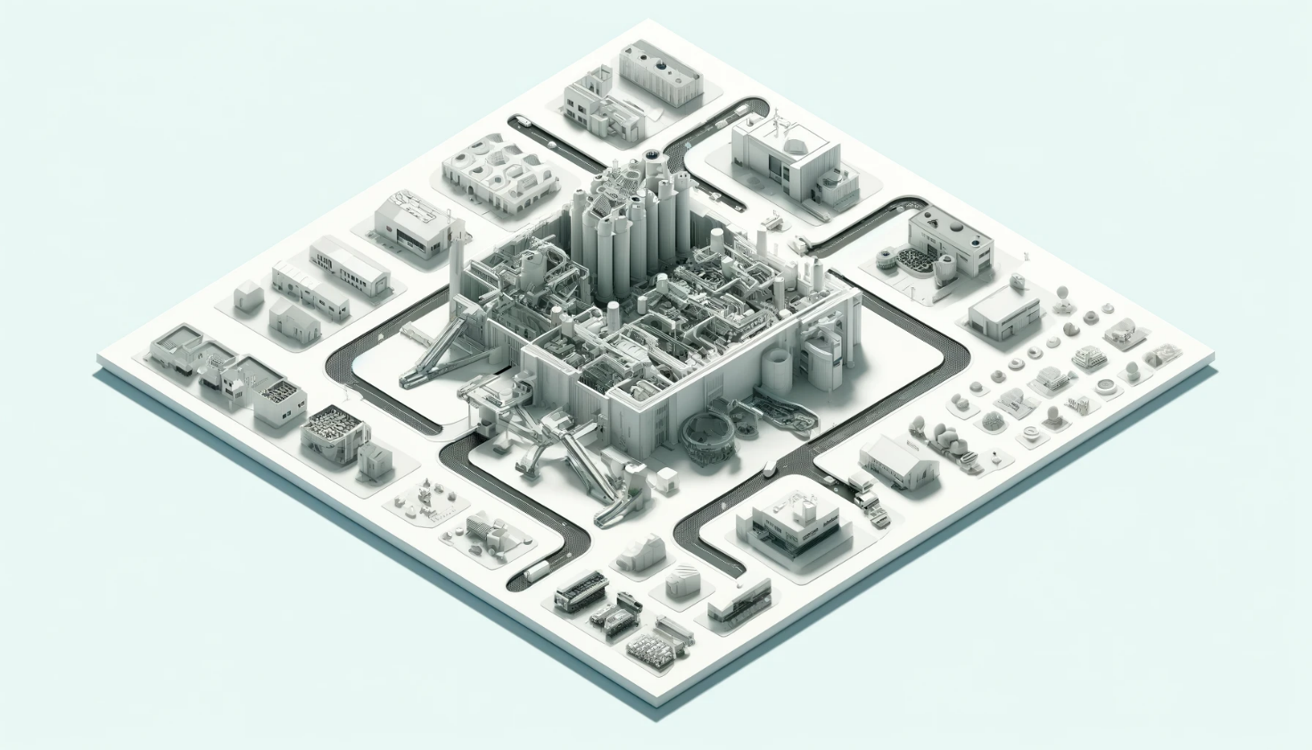
Waste2X hub
Waste2X is one of the 9 prioritized projects in the growth strategy developed by Skive municipality, the companies and the educational institutions and anchored in this triple helix.
The industrial automation of residual waste is the core of an area in Skiveegnen, which is to be developed as a cluster for sorting construction and industrial waste.
As a derivative effect of this, companies will arise. These companies will further process the sorted fractions and sell these as new raw materials to produce e.g., building materials.
We want to establish the first step for such an area in the Skive area

